Slide 1

DairyDynamics: Dairy Product Management
Domain :
Utilities – Web Development
Problem Statement Title: DairyDynamics: Dairy Product Management
UN Sustainable Development Goal :
The sustainable goal related to dairy product management is Goal 12: Responsible Consumption and Production.
This goal aims to ensure that we consume and produce resources in a way that is sustainable for the planet and future generations. For dairy products, this means producing and consuming them in a way that reduces waste, protects the environment, and supports fair labor practices.
Vansh Patel (21IT124)
Preksha Rana (21IT134)
Het Shah (21IT141)

Slide 2
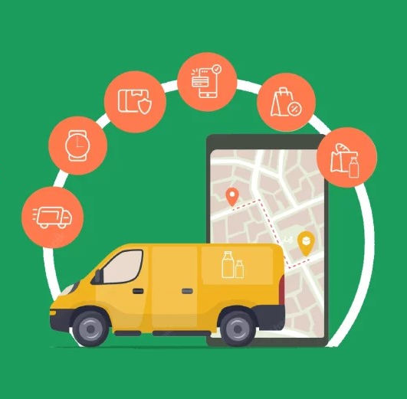
Project Overview
DairyDynamics-Dairy Product Management System is envisioned as a comprehensive platform designed to streamline and enhance the management of dairy products across multiple branches of a dairy business.
This system aims to centralize the key operations involved in tracking sales, monitoring payment methods, and generating detailed reports, all while ensuring seamless communication and data flow between various branches.
The primary goal of the system is to provide dairy businesses with a robust tool that simplifies the complexities of managing a wide range of dairy products, including milk, cheese, yogurt, butter, and other related products.
By leveraging modern technology, the system will offer real-time data insights, enabling businesses to make informed decisions, optimize operations, and ultimately increase profitability.

Slide 3
Dairy Market Analysis
In the upcoming three years, the diary management software market will witness a compounded annual growth rate of 10.28%. By 2027, we can expect the global dairy farm management software market to be worth around $4.88 billion.
Challenges Faced by the Dairy Farm Businesses:
Technology Costs: Dairy Farm businesses have low profit margins and don’t have hefty budgets to implement new technologies or infrastructure.
Poor Efficiency: Workflows in this sector are vastly fragmented. There is a lot of supply chain disruption. As a result, dairy farm owners bear massive losses due to delays and missed opportunities.
No Online Visibility: Even today, most dairy farmers operate physically. They’re yet to launch their business online or drive sales through company branding and digital marketing. All of these challenges can be addressed by simply implementing dairy farm management software.

Slide 4
Project Details
To develop a comprehensive dairy product management system that allows multiple branches to efficiently track and manage product sales, monitor payment methods, manage users, and generate detailed sales reports.
Product Sales Amount: Track the total revenue generated by each product at each branch.
Sales Quantity: Monitor the number of units sold for each product at each branch.
Used Payment Methods Count: Analyze the popularity of different payment methods (e.g., cash, online, digital wallets) at each branch.
User and Branches: Maintain a database of customers and branches to associate sales data with specific entities.
Sales Report Generation: Create comprehensive reports that summarize sales performance across products, branches, and payment methods.

Slide 5
Core Components of the System
Multi-Branch Sales Management: The system will allow businesses to track sales data across multiple branches in real-time. Each branch can record sales transactions, which are then automatically synced with a central database.
Payment Method Tracking: The system will track various payment methods used by customers, such as cash, credit/debit cards, digital wallets, and other payment options. This feature will not only help in financial reconciliation but also provide insights into customer payment preferences, allowing the business to adapt to changing trends.
User and Role Management: The system will support multiple user roles, such as administrators, branch managers, and sales staff, each with specific permissions.
Sales Reporting and Insights: One of the key features of the system will be its ability to generate customizable sales reports. These reports will include data on sales volumes, revenue, product performance, and customer behavior, which can be filtered by date, branch, product type, and payment method.
Sustainability and Waste Reduction: In alignment with sustainability goals, the system will include features that track and analyze waste in the supply chain, helping the business to identify areas where improvements can be made to reduce environmental impact.

Slide 6
Implementation Strategy
Implementation Steps:
Requirement Gathering: Collect detailed requirements from stakeholders for features and functionality.
Design: Create wireframes and figma design for the user interface. Design database schema to handle multi-branch data efficiently.
Development:
Implement the core features, starting with user management and branch setup.
Develop the dashboard to display real-time sales data.
Integrate payment method tracking and reporting functionality.
Testing: Conduct thorough testing, including unit testing, integration testing, and user acceptance testing.
Deployment: Deploy the system on a cloud platform and ensure scalability.

Slide 7
Implementation Strategy
Technology stack:
React.js: For front-end development of website by building interactive user interfaces and reusable components.
Node.js: For back-end development of website which provides an event-driven, non-blocking I/O model for building real-time applications.
Express.js: For building web applications and APIs, facilitating the development of server-side applications.
SQL: For managing and manipulating relational databases by data retrieval, insertion, updating, and deletion.
Figma: For creating a user-friendly and visually appealing UI interface.

Slide 8
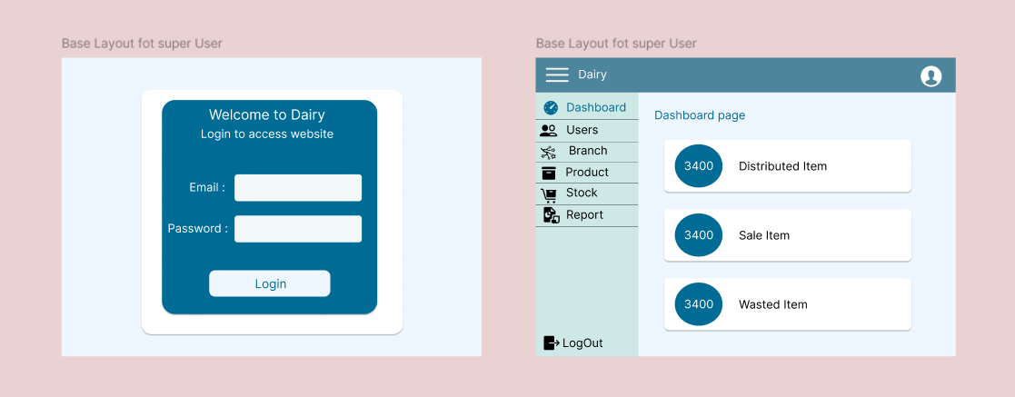
UI Design
Understanding project requirements and creating UI designs using Figma.
Finalized UI design of login page and dashboard of project.

Slide 9
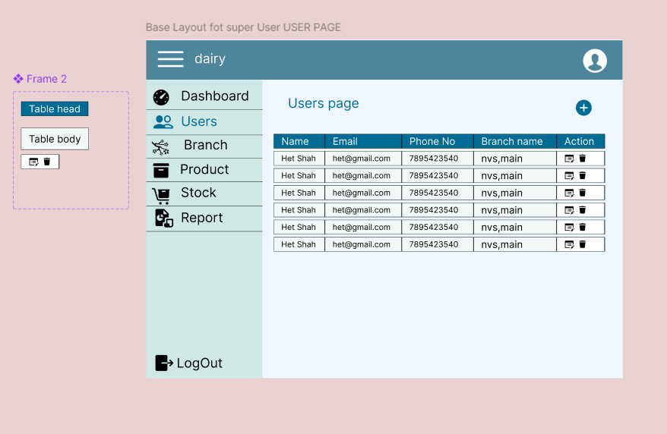
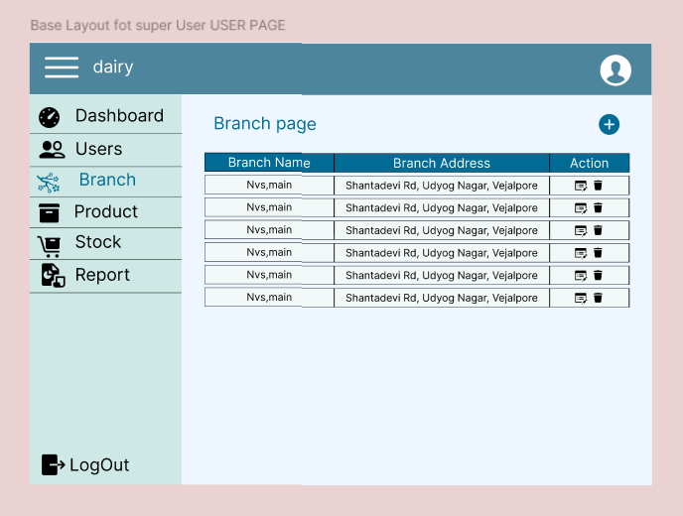
UI Design
Finalized UI design of user page and branch page.

Slide 10
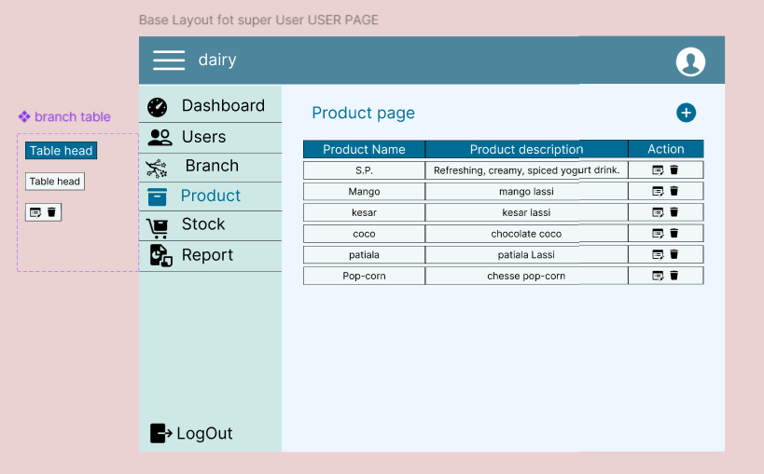
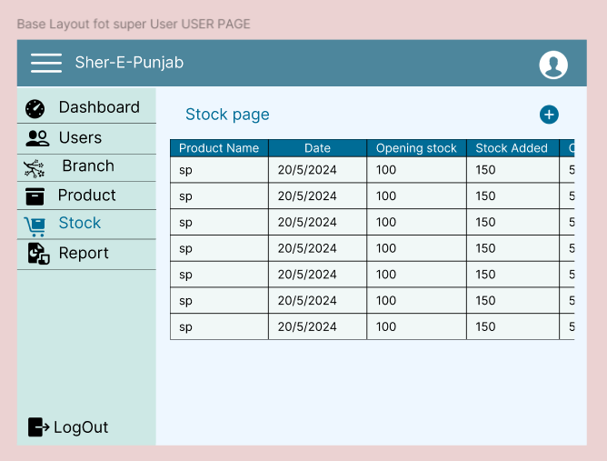
UI Design
Finalized UI design of product page and page for stock management.

Slide 11
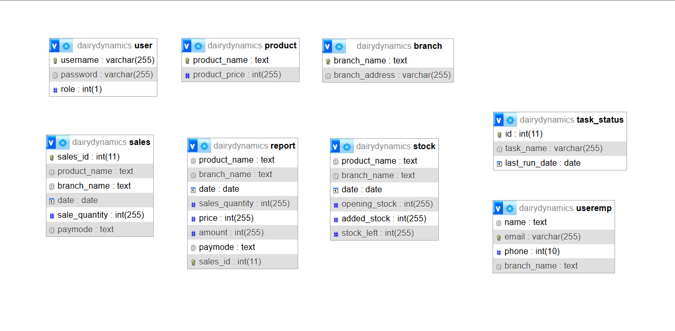
Database Design Schema

Slide 12
Thank You!

